Slide 1


JAVA Java Interview boot camp Core concepts
Lecture 20
CHAPTER 18
Nested/Inner Classes

Slide 2
What Is A Nested Class ?
Classes defined within the body of another class (or interface) are known as nested classes.
Normally we define a class, which is a top-level class directly belonging to a package.
In contrast, nested classes are classes contained within another class or interface.

Slide 3
Example
public class Car {
// members of Car
class Engine {
// members of Engine
}
}

Slide 4
Benefits Of Nested Class
Grouping Related Code Together:
Some classes are only useful to others, e.g. the Engine class and Car class in the above example.
By using nested classes, related code is grouped together which gives us more flexibility and controllability in writing code.

Slide 5
Benefits Of Nested Class
Increasing Code Encapsulation:
Consider the previous example - the nested class Engine is encapsulated inside the Car class, which protects the Engine class from the outside world.

Slide 6
Benefits Of Nested Class
Making the code more readable and maintainable:
Indeed, nested classes help us write more readable and maintainable code, as shown in the above example: when reading the Car class, we can also navigate to the Engine class and make update quickly within the same source file.

Slide 7
Types Of Nested Classes
There are four types or flavours of nested classes in Java:
• Static nested class
• Inner class
• Local inner class
• Anonymous inner class

Slide 8
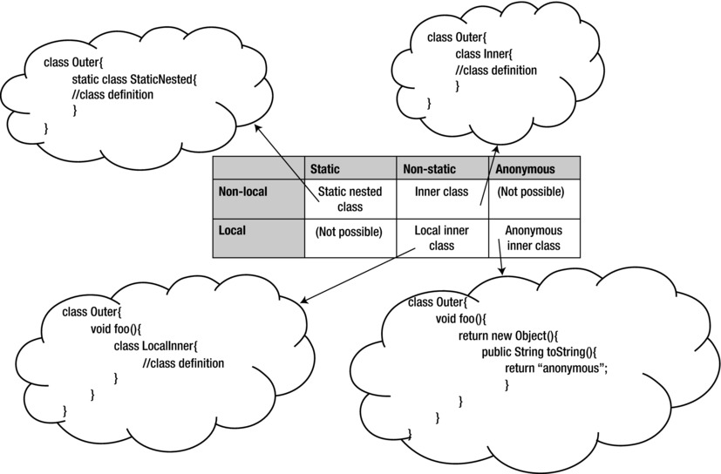
Types Of Nested Classes

Slide 9
Types Of Nested Classes
A local class is defined within a code block (code block means a method, constructor, or initialization block)
A non-local class is defined inside a class.
A static class is qualified using the static keyword.
In an anonymous class, we don’t provide the name of the class; we just define its body!

Slide 10
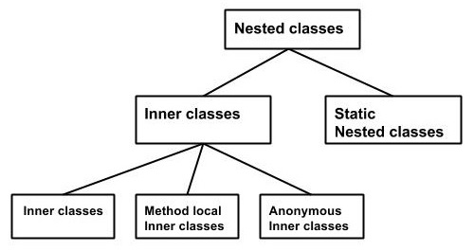
Types Of Nested Classes

Slide 11
Static Nested Class
We can define a class (or interface) as a static member inside another class (or interface).
Since the outer type can be a class or an interface and the inner ones can also be a class or interface, there are four combinations.

Slide 12
Four Types Of Static Nested Class/Interface
class Outer { // an outer class has a static nested class static class Inner { } } interface Outer { // an outer interface has a static nested class static class Inner { } } class Outer { // an outer class has a static nested interface static interface Inner { } } interface Outer { // an outer interface has a static nested interface static interface Inner { } }

Slide 13
Static Nested Class
A nested class is marked with static modifier is called the static nested class.
Here’s an example:
public class Car {
static class Wheel {
public void rotate() {
System.out.println("The wheel is rotating...");
}
}
}

Slide 14
Static Nested Class
Here, Wheel is a static nested class which is enclosed in the Car class.
The following code illustrates how to instantiate an object of the static nested class:
Car.Wheel wheel = new Car.Wheel();
wheel.rotate();

Slide 15
Exercise
Create a static nested class called Color declared inside a class called Shape.
Provide three data members called red , green and blue in the class Color and a parametrized constructor to initialize them with the values passed.
Also provide an overridden toString() method.
Finally inside the main() method instantiate the Color class and display the details of the objects

Slide 16
Solution
class Shape { public static class Color { int red, green, blue; public Color(int red, int green, int blue) {
this.red=red;
this.green= green;
this.blue = blue; }
public String toString() { return " red = " + red + " green = " + green + " blue = " + blue; } } }

Slide 17
Solution
public class TestColor { public static void main(String []args) {
Shape.Color white = new Shape.Color(255, 255, 255);
System.out.println("White color has values:" + white); }
}
Output:
White color has: red = 255 green = 255 blue = 255

Slide 18
Points To Remember About SNC
Static nested classes are sometimes referred to as static inner classes, but they aren't inner classes at all, by the standard definition of an inner class.
A static nested class does not have that special-relationship that inner classes have, i.e. they cannot access the instance methods or variables of outer class.

Slide 19
Points To Remember About SNC
public class Car {
private int weight;
private static String brand;
static class Wheel {
public void rotate() {
// cannot access instance variables of the enclosing class
weight = 5;
// can access static members of the enclosing class
brand = "Honda";
}
}
}

Slide 20
Points To Remember About SNC
As we can see, the static nested class cannot have direct access to instance members of the enclosing class.
However it can access these members via object reference of the enclosing class.

Slide 21
Points To Remember About SNC
public class Car {
private int weight;
private static String brand;
static class Wheel {
public void test(Car car) {
car.weight = 5000;
System.out.println("car's weight is: " + car.weight);
}
}
}

Slide 22
Points To Remember About SNC
When we define an inner nested class (or interface) inside an interface, the nested class is declared implicitly public and static.
This point is easy to remember: any field in an interface is implicitly declared as public and static, and static nested classes have this same behavior.

Slide 23
Points To Remember About SNC
Static nested classes can be declared abstract or final.
public class GeoLocation {
public static abstract class LocationResult{
public abstract void printLocation();
}
}
Static nested classes can extend another class or it can be used as a base class.

Slide 24
Points To Remember About SNC
For example , to use the class LocationResult, we could create a class extending it using extends as shown:
class MyLocation extends GeoLocation.LocationResult { . . . }
and use it with
GeoLocation.LocationResult instance = ...

Slide 25
Points To Remember About SNC
Static nested classes can access the members of the outer class (only static members, obviously).
The outer class can also access the members (even private members) of the nested class through an object of nested class.
If we don’t declare an instance of the nested class, the outer class cannot access the nested class elements directly.

Slide 26
What Is The Use Of Static Nested Class?
Static nested class is used in the builder pattern.
Static nested class can instantiate it's outer class even if it has a private constructor.
We can not do the same with the inner class as we need to have object of the outer class created prior to accessing the inner class.

Slide 27
What Is The Use Of Static Nested Class?
class OuterClass {
private OuterClass(int x) {
System.out.println("x: " + x);
}
static class InnerClass {
public static OuterClass createOuter() {
OuterClass outer = new OuterClass(1);
return outer;
}
}
}
public class Test {
public static void main(String[] args) {
// It is not possible to create outer instance from outside.
// OuterClass outer = new OuterClass(1);
OuterClass outer=OuterClass.InnerClass.createOuter();
}
}

Slide 28
Example
public class Pizza {
//required parameters
private String name;
private String size;
//optional parameters
private boolean withExtraCheese;
private Boolean withExtraTomato;
}
Challenge:
Write code to initialize object of Pizza class in a single line of code

Slide 29
Solution 1
The simplest way that comes to our mind for instantiating and initializing a Pizza object is to create a Constructor.
The Constructor will accept 4 arguments and will use them to initialize the object.

Slide 30
Solution 1
public class Pizza {
//required parameters
private String name;
private String size;
//optional parameters
private boolean withExtraCheese;
private boolean withExtraTomato;
//a public constructor
public Pizza(String name,String size,boolean withExtraCheese,boolean withExtraTomato) {
this.HDD=HDD;
this.RAM=RAM;
this.withExtraCheese= withExtraCheese;
this.withExtraTomato= withExtraTomato;
}
….
}

Slide 31
Problems
Although the code will work fine but there are 3 issues:
What if we do not want to pass any value to optional parameters ?
What will happen if the class contains many members ?
How will a new developer who tries to instantiate those class remember the order of arguments ?

Slide 32
Another Example
public class Computer {
//required parameters
private String HDD;
private String RAM;
//optional parameters
private boolean isGraphicsCardEnabled;
private boolean isBluetoothEnabled;
}
Challenge:
Write code to initialize object of Computer class in a single line of code

Slide 33
Solution 1
The simplest way that comes to our mind for instantiating and initializing a Computer object is to create a Constructor.
The Constructor will accept 4 arguments and will use them to initialize the object.

Slide 34
Solution 1
public class Computer {
//required parameters
private String HDD;
private String RAM;
//optional parameters
private boolean isGraphicsCardEnabled;
private boolean isBluetoothEnabled;
//a public constructor
public Computer(String HDD,String RAM,Boolean isGraphicsCardEnabled,Boolean isBluetoothEnabled) {
this.HDD=HDD;
this.RAM=RAM;
this.isGraphicsCardEnabled=isGraphicsCardEnabled;
this.isBluetoothEnabled=isBluetoothEnabled;
}
….
}

Slide 35
Problems
Although the code will work fine but there are 3 issues:
What if we do not want to pass any value to optional parameters ?
What will happen if the class contains many members ?
How will a new developer who tries to instantiate those class remember the order of arguments ?
To understand these problems , imagine we want to instantiate a SmartHome class as shown in next slide

Slide 36
Problems
public class SmartHome {
private String name;
private int serialNumber;
private String addressName;
private String addressNumber;
private String city;
private String country;
private String postalCode;
private int light1PortNum;
private int light2PortNum;
private int door1PortNum;
private int door2PortNum;
private int microwavePortNum;
private int tvPortNum;
private int waterHeaterPortNum;
public SmartHome(String name, int serialNumber, String addressName, String addressNumber, String city, String country, String postalCode, int light1PortNum, int light2PortNum, int door1PortNum, int door2PortNum, int microwavePortNum, int tvPortNum, int waterHeaterPortNum) {
// Assigning values in the constructor call
}
// Getters and Setters
}

Slide 37
Problems
We face too many arguments in the constructor, and with low type-variety, we'll be looking at a huge constructor call with no way of knowing what's what.
The code has become unreadable and incomprehensible

Slide 38
A Better Solution
This is where the Builder Pattern jumps in:
The Builder Pattern separates the construction from the representation.
What does this mean?

Slide 39
A Better Solution
The construction is done in the class itself.
The representation is what we see as the user of the class.
Right now, our classes have these two tied together - we directly call the constructor with the passed arguments.
By separating these two, we can make the representation of the class a lot simpler, neater and readable, while the constructor does its part.

Slide 40
How To Implement Builder Design Pattern ?
There are few steps to take in order to implement the Builder Pattern.
Continuing with our first example, we'll use the Computer class to show these steps:
A static builder class should be nested in our Computer class
The Computer constructor should be private so the end-user can't call it
The builder class should have an intuitive name, like ComputerBuilder
The ComputerBuilder class will have the same fields as the Computer class

Slide 41
How To Implement Builder Design Pattern ?
The fields in the Computer class can be final or not, depending if we want it to be immutable or not
The ComputerBuilder class will contain methods that set the values, similar to setter methods.
These methods will feature the ComputerBuilder as the return type, assign the passed values to the fields of the static builder class
The static builder class will contain a build() method that injects these values into Computer and returns an instance of it.

Slide 42
Solution 2
public class Computer {
//required parameters
private String HDD;
private String RAM;
//optional parameters
private boolean isGraphicsCardEnabled;
private boolean isBluetoothEnabled;
public String getHDD() {
return HDD;
}
public String getRAM() {
return RAM;
}

Slide 43
Solution 2
public boolean isGraphicsCardEnabled() {
return isGraphicsCardEnabled;
}
public boolean isBluetoothEnabled() {
return isBluetoothEnabled;
}
private Computer(ComputerBuilder builder) {
this.HDD=builder.HDD;
this.RAM=builder.RAM;
this.isGraphicsCardEnabled=builder.isGraphicsCardEnabled;
this.isBluetoothEnabled=builder.isBluetoothEnabled;
}

Slide 44
Solution 2
//Builder Class
public static class ComputerBuilder{
// required parameters
private String HDD;
private String RAM;
// optional parameters
private boolean isGraphicsCardEnabled;
private boolean isBluetoothEnabled;
public ComputerBuilder(String hdd, String ram){
this.HDD=hdd;
this.RAM=ram;
}

Slide 45
Solution 2
public ComputerBuilder setGraphicsCardEnabled(boolean isGraphicsCardEnabled) {
this.isGraphicsCardEnabled = isGraphicsCardEnabled;
return this;
}
public ComputerBuilder setBluetoothEnabled(boolean isBluetoothEnabled) {
this.isBluetoothEnabled = isBluetoothEnabled;
return this;
}
public Computer build(){
return new Computer(this);
}
}
}

Slide 46
Solution 2
public class TestBuilderPattern {
public static void main(String[] args) {
Computer comp = new Computer
.ComputerBuilder("500 GB", "2 GB")
.setBluetoothEnabled(true)
.setGraphicsCardEnabled(true)
.build();
}
}

Slide 47
Inner Class
We can define a class (or an interface) as a non-static member inside another class.
How about declaring a class or an interface inside an interface?
As we saw in earlier slide when we define a class or an interface inside an interface, it is implicitly static.
So, it is not possible to declare a non-static inner interface!

Slide 48
Inner Class
That leaves two possibilities:
class Outer { // an outer class has an inner class class Inner { } } class Outer { // an outer class has an inner interface interface Inner { } }

Slide 49
Exercise
Create a Point class to implement the center of a Circle.
Since we want to associate each Circle with a centerPoint, make Point an inner class of Circle.

Slide 50
Exercise
The class Point should have 2 int variables to represent x and y axis value of the point.
Also it should have a parametrized constructor to initialize the Point object and an overridden toString() method.

Slide 51
Exercise
The class Circle should have an integer radius and a Point object as it’s data member.
Also it should have a triple argument parametrized constructor to initialize all the data members and an overridden toString() method.

Slide 52
Example
public class Circle { // define Point as an inner class within Circle class class Point { private int xPos; private int yPos; // constructor for an inner class public Point(int x, int y) { xPos = x; yPos = y; } // overridden method public String toString() { return "(" + xPos + "," + yPos + ")"; } }

Slide 53
Example
// make use of the inner class for declaring a field private Point center; private int radius; public Circle(int x, int y, int r) { // use of the inner class to instantiate it center = this.new Point(x, y); radius = r; } public String toString() { return "mid point = " + center + " and radius = " + radius; } public static void main(String []s) { System.out.println(new Circle(10, 10, 20)); } // other methods such as area }
Output:
Mid point=(10,10) and radius=20

Slide 54
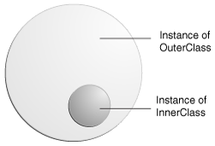
Points To Remember About Inner Class
Every inner class is associated with an instance of the outer class. In other words, an inner class is always associated with an enclosing object.

Slide 55
Points To Remember About Inner Class
It means that without a reference to an instance of the outer class, we can’t instantiate the inner class from a static method of the outer class (because, don’t forget, in static code, there is no this reference), or from any other code in any other class.
Inner class instances are always handed an implicit reference to the outer class.

Slide 56
Points To Remember About Inner Class
The outer and inner classes share a special relationship, like friends or members of same family. Member accesses are valid irrespective of the access specifiers such as private.
However, there is subtle difference.
We can access members of an outer class within an inner class without creating an instance; but this is not the case with an outer class.
We need to create an instance of inner class in order to access the members (any members, including private members) of the inner class.

Slide 57
Points To Remember About Inner Class
One limitation of inner classes is that we cannot declare static members in an inner class, like this:
class Outer { class Inner { static int i = 10; } }
If we try to do so, we’ll get the following compiler error:
Outer.java:3: inner classes cannot have static declarations static int i = 10;

Slide 58
Points To Remember About Inner Class
Just like top-level classes, an inner class can extend a class or can implement interfaces.
Similarly, an inner class can be extended by other classes, and an inner interface can be implemented or extended by other classes or interfaces.
An inner class can be declared final or abstract

Slide 59
Points To Remember About Inner Class
If we want to create an instance of the inner class, we must have an instance of the outer class.
The syntax is:
<OuterClass.InnerClass> <objref>=<outerobjref>.new <InnerClass()>
For example:
Outer out=new Outer();
Outer.Inner in=out.new Inner();

Slide 60
Points To Remember About Inner Class
Can you make a one liner for the previous code ?
Yes:
Outer.Inner in=new Outer().new Inner();

Slide 61
Points To Remember About SNC
When we define an inner nested class (or interface) inside an interface, the nested class is declared implicitly public and static.
This point is easy to remember: any field in an interface is implicitly declared public and static, and static nested classes have this same behavior.

Slide 62
Referencing Inner/Outer Instance From Inner Class
Within an inner class code, the this reference refers to the instance of the inner class, since this always refers to the currently executing object.
But what if the inner class code wants an explicit reference to the outer class instance that the inner instance is tied to?
In other words, how do we reference the “outer this”?

Slide 63
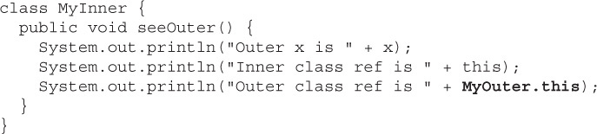
Referencing Inner/Outer Instance From Inner Class
This is done using <outerclassname>.this.
MyOuter is the name of the Outer class

Slide 64
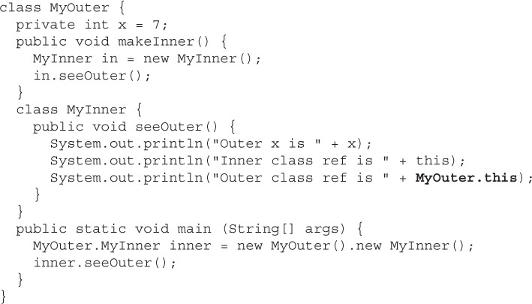

Referencing Inner/Outer Instance From Inner Class
Output:

Slide 65
Conclusions About “this”
To reference the inner class instance itself from within the inner class code, use this.
To reference the “outer this” (the outer class instance) from within the inner class code, use NameOfOuterClass.this(example, MyOuter.this).

Slide 66
Modifiers Applied To Inner Class
A regular inner class is a member of the outer class just as instance variables and methods are, so the following modifiers can be applied to an inner class:
final
abstract
public
private
protected
static—but static turns it into a static nested class, not an inner class
strictfp

